Slide 1
School Admission
One-Stop
SSP4 Team Nugget
Lin Zixing
Terrence Ong
Fabian Wong
Russell Wong

Slide 2
TABLE OF CONTENTS
01
02
03
04
05
06
Introduction
Functionalities
Design Process and Architecture
What is School Admission One-Stop?
What can it do?
How was it done?
Testing
Challenges Faced
Demo
How are functionalities ensured?
What are some issues and potential improvements?
Showcase of the application

Slide 3
01
Introduction

Slide 4
INTRODUCTION
PROBLEM
SOLUTION
It is hard to find and keep track of all institution's requirements on the internet
Create an app that collates all information in one location with value added features
Notes:
Our teams focus was on how to make applying for the next step of education an easier one.
Seeing as there was no one stop solution for this, we decided to design an application which could be used for this purpose.
We also wanted to have the ability to search for courses by GPA intake requirements and institute

Slide 5
School Admission One-Stop
Features:
Institute’s entry requirements
Course descriptions
Student CCAs
Search Function
Filtered Search
By Team Nugget

Slide 6
02
Functionalities

Slide 7
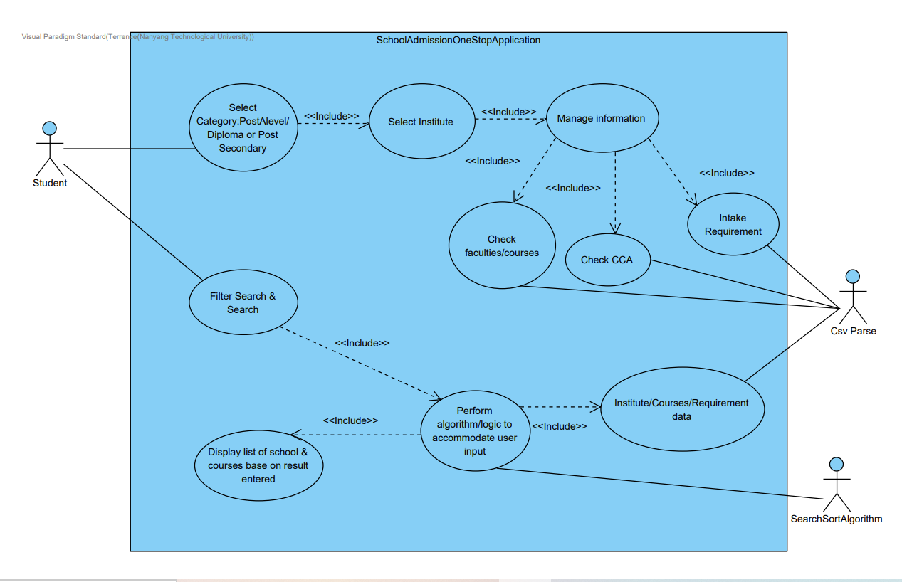
Use Case Diagram

Slide 8
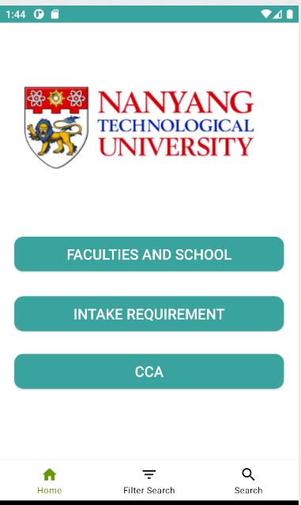
Manage Information
One stop institute page to find out information about faculties & courses.
Student may access a list of entry requirement of a particular institute.
A list of cca offered by the school can be accessed .

Slide 9
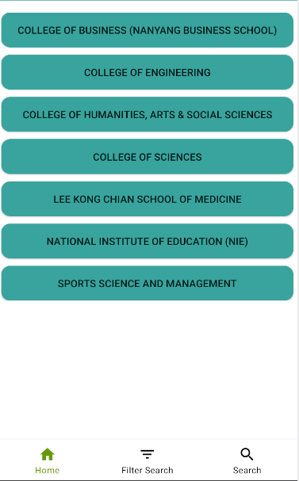
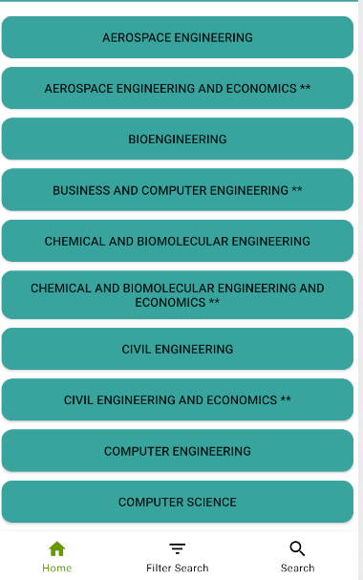

Faculties & School

Slide 10
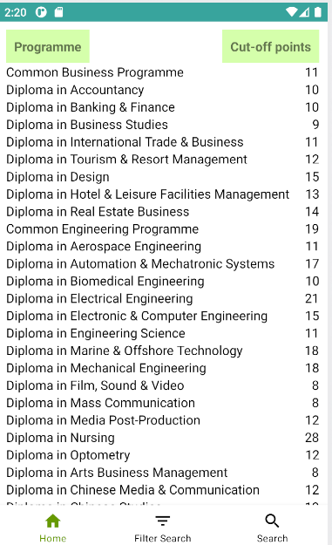
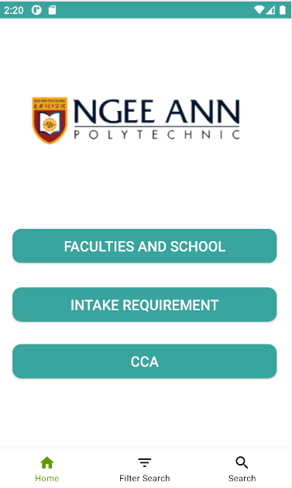
Intake Requirement

Slide 11
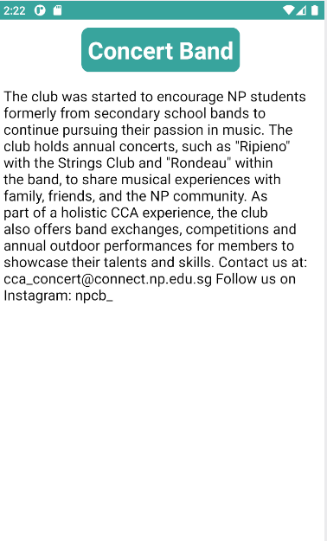
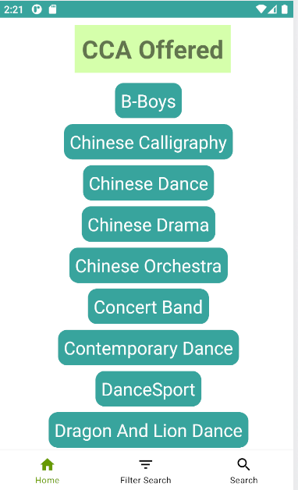
CCA & CCA Description

Slide 12
Use Case Diagram

Slide 13
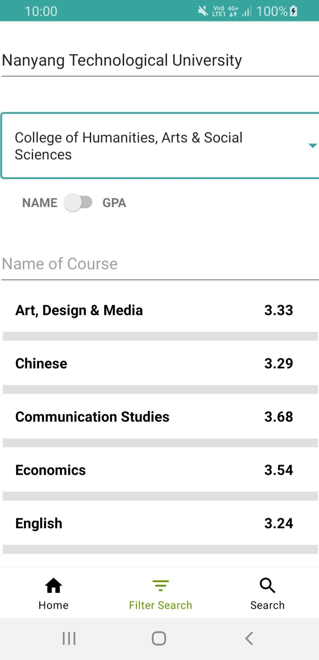
Filter Search
Provides users with a series of options to search for a list of courses in the app
Based on
GPA
Course Name

Slide 14
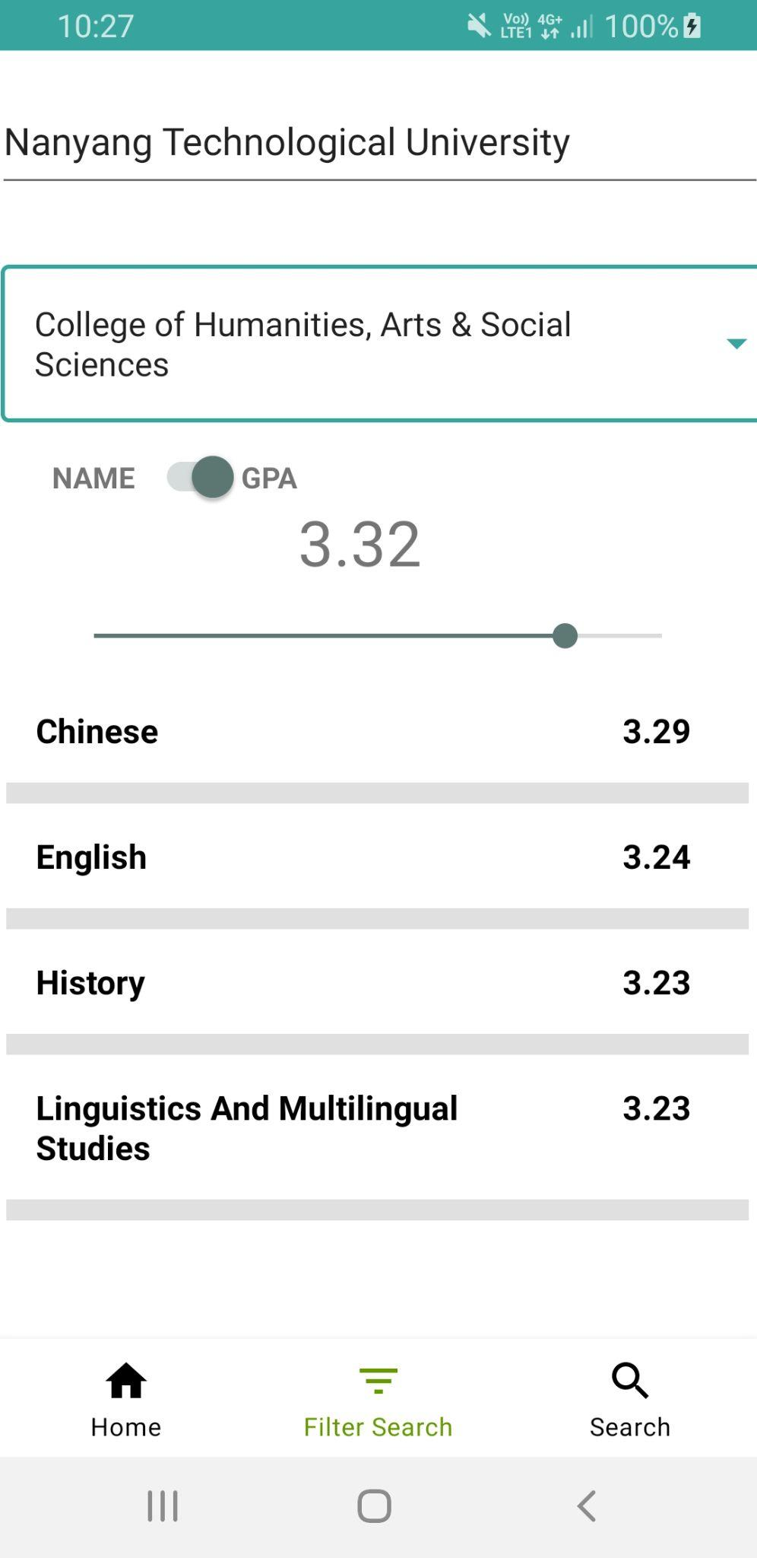
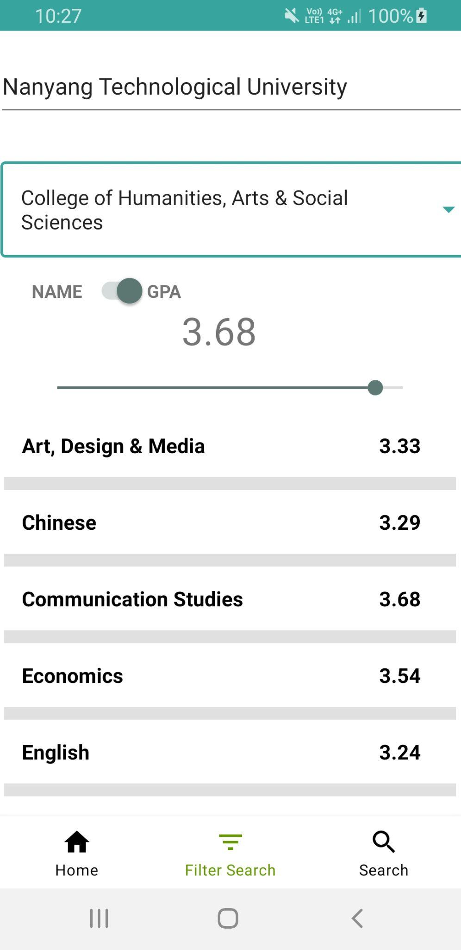
Filter Search

Slide 15
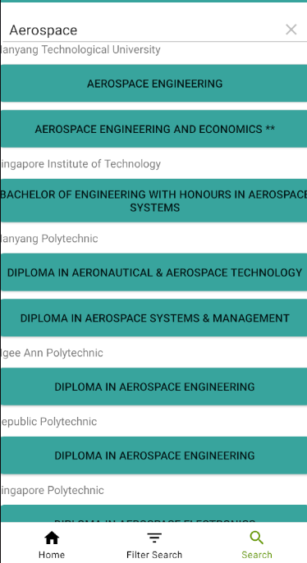
Search
An open ended search bar for to student to search courses across different institute.

Slide 16
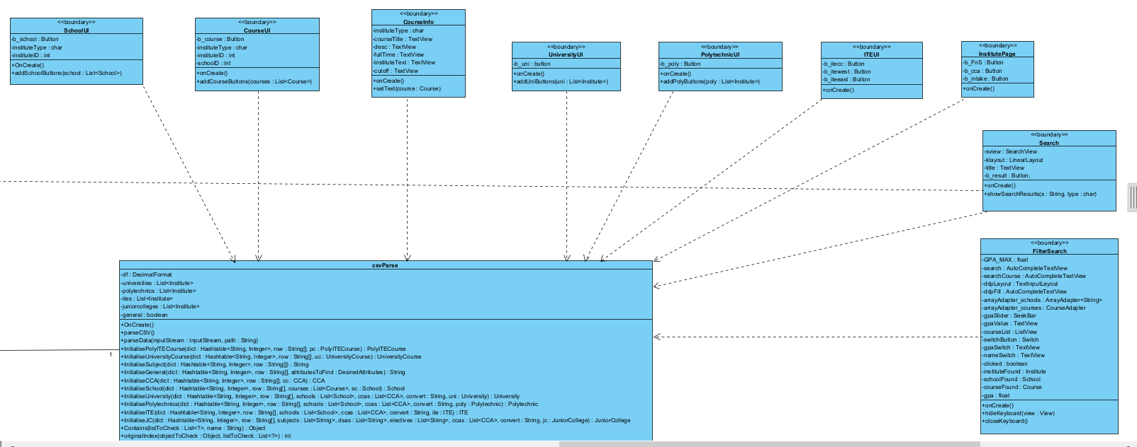
Class Diagram

Slide 17
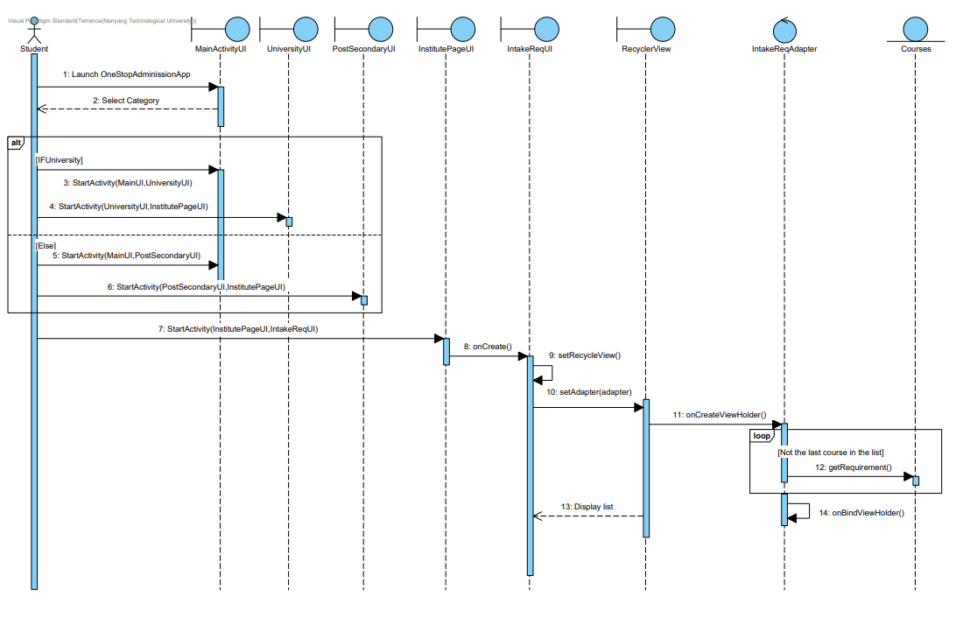
SD Intake Requirement

Slide 18
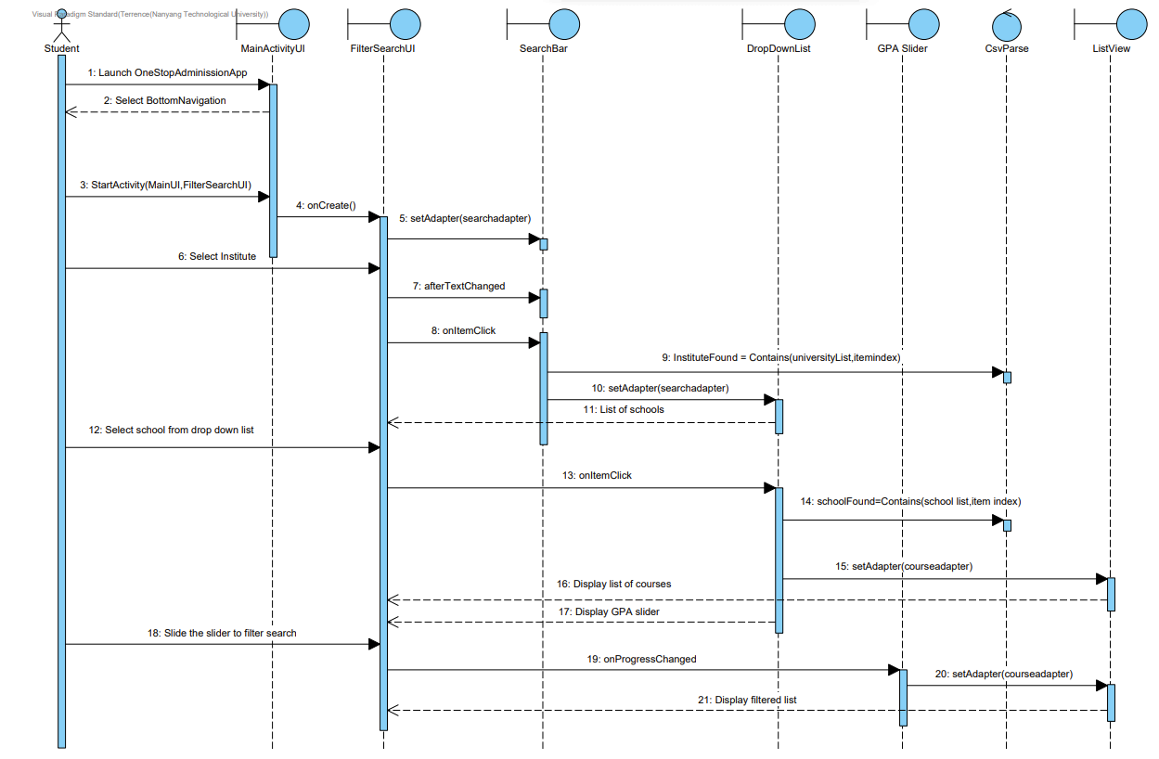
SD Filter Search

Slide 19
03
Design Process and Architecture

Slide 20
Design Process
Phase 1 (2 weeks):
Requirements Elicitation
Phase 2 (2 weeks):
Requirements Analysis
Preliminary Design and Implementation
Phase 3 (5 weeks):
Design and Implementation
Phase 4 (~ 2 weeks):
Testing
Final touch ups and documentation

Slide 21
Development Tools
Development Platform
Operating System/Device
SVN: GitHub
Design Tool: Visual Paradigm
Dev Tool: Android Studio
Android devices running Android OS Nougat 7.0 and above
Dataset
Test Device
Main: data.gov.sg
Alt: School Websites
Google Pixel 3 XL

Slide 22

Presentation Layer
AppUI
App Logic
csvParse
InstituteManager
SchoolManager
CourseManager
SearchSortAlgorithm
Persistent Data
CSV Dataset

Slide 23
04
Testing

Slide 24
Testing Methods
Black Box
White Box
Equivalent Classes
SearchSortAlgorithm
Flow Testing
csvParse

Slide 25
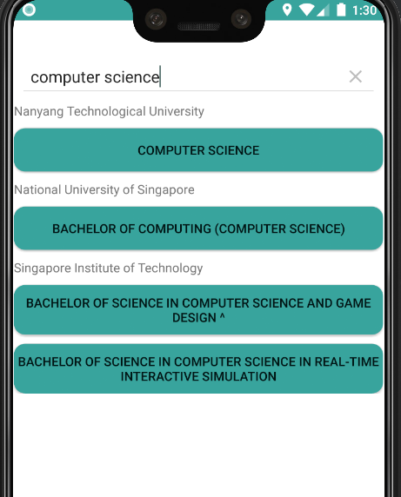
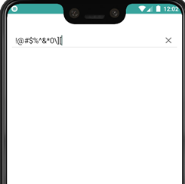
Black Box Testing
Test cases designed based on input into the Search page of the application
Equivalent Classes {Valid Input, Invalid Input}
Control Classes tested: SearchSortAlgorithm, InstituteManager, SchoolManager, CourseManager
Test Case | Input | Expected Output | Actual Output | Successful
1 | computer science | List of courses from various schools with “computer science” in its name | NTU Computer Science NUS Bachelor of Computing (Computer Science) SIT Bachelor of science in computer science and game design SIT Bachelor of science in computer science in real-time interactive simulation | Yes
2 | !@#$%^&*0\][ | No results | No results | Yes

Slide 26
White Box Testing
Test Cases designed based on logical flow and decision making within the application
Control Classes tested: csvParse, InstituteManager, SchoolManager, CourseManager

Slide 27
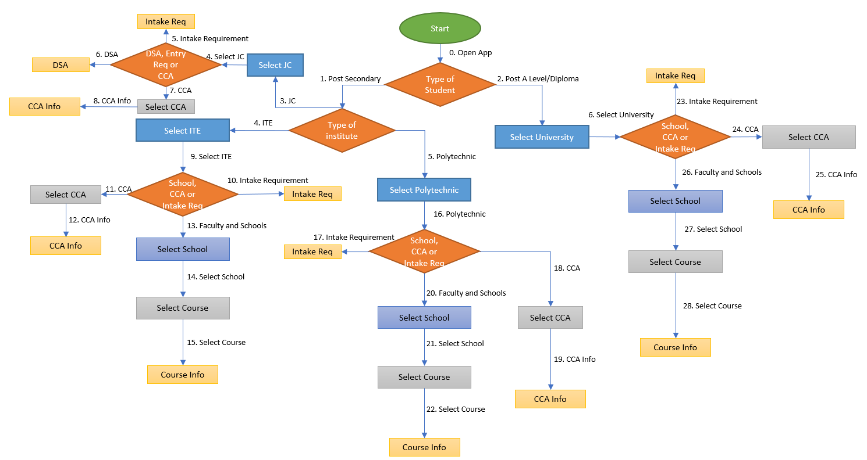
Notes:
Maybe add indication of test case

Slide 28
White Box Testing
Test Cases designed based on logical flow and decision making within the application
Control Classes tested: csvParse, InstituteManager, SchoolManager, CourseManager
Some examples will be shown in the demo later
Test Case | Input | Expected Output | Actual Output | Successful
1 | 0,1,3,4,6 | DSA Requirements for selected JC | DSA Requirements for selected JC | Yes
2 | 0,2,6,26,27,28 | Course Information for selected University | Course Information for selected University | Yes

Slide 29
05
Challenges Faced

Slide 30
Why is UI a serious issue ?
There are now more than 24,000 different Android devices
Challenges #1 User interface

Slide 31
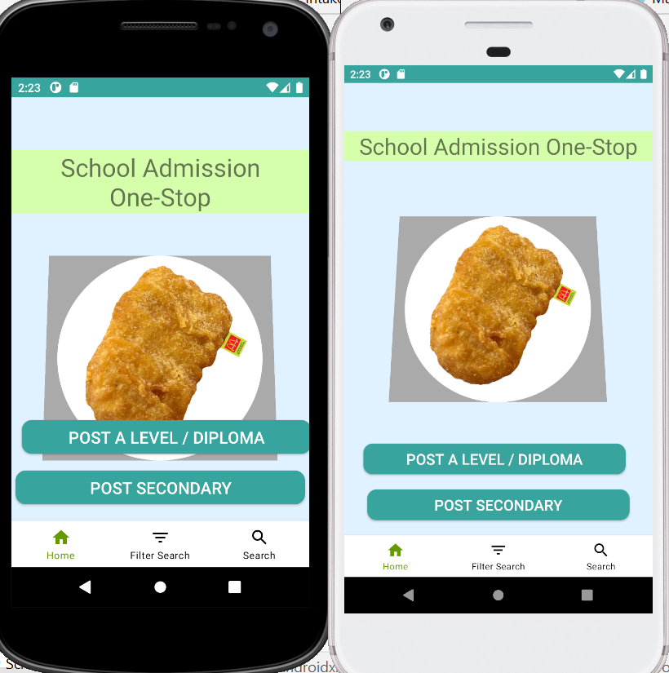
Challenges #1 User interface

Slide 32
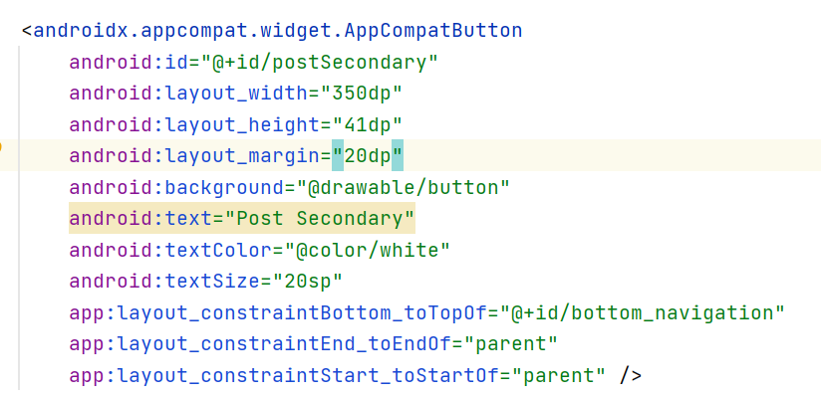
We initially hardcoded the absolute distance of the buttons and widgets.
Challenges #1 User interface

Slide 33
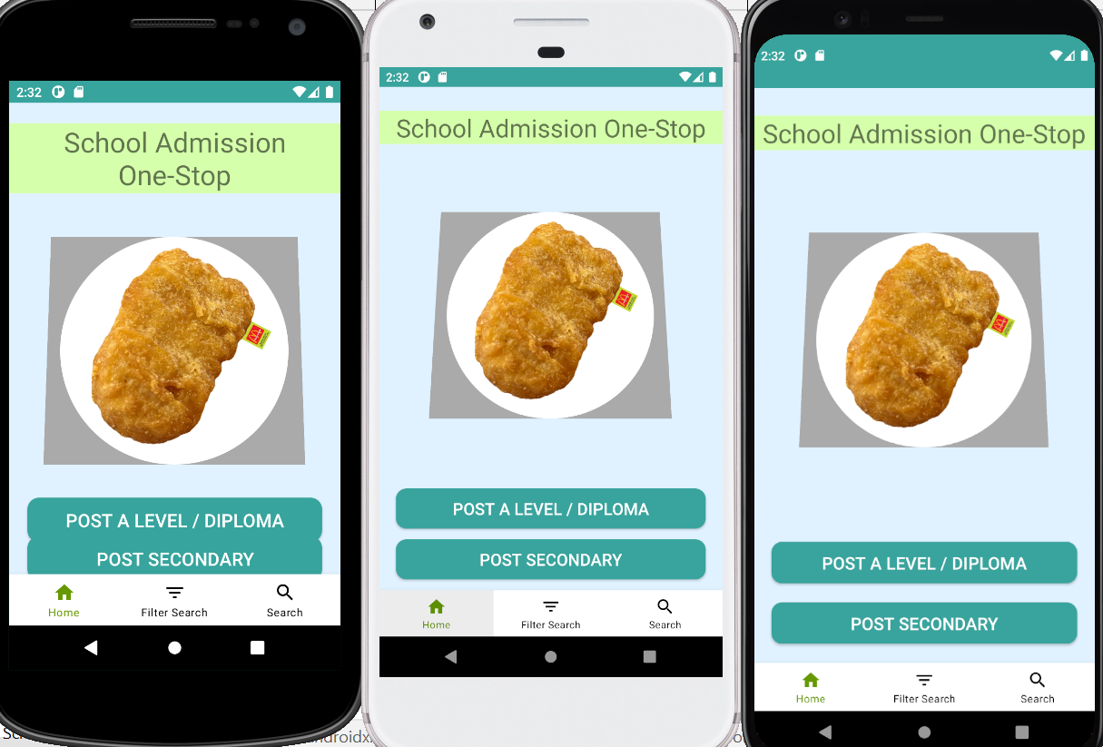
Solution:
Relative distancing & Apply constraint
Challenges #1 User interface

Slide 34
We have multiple data set we need to read.(Institute/Courses/CCA)
Challenges #2 Reading data efficiently

Slide 35
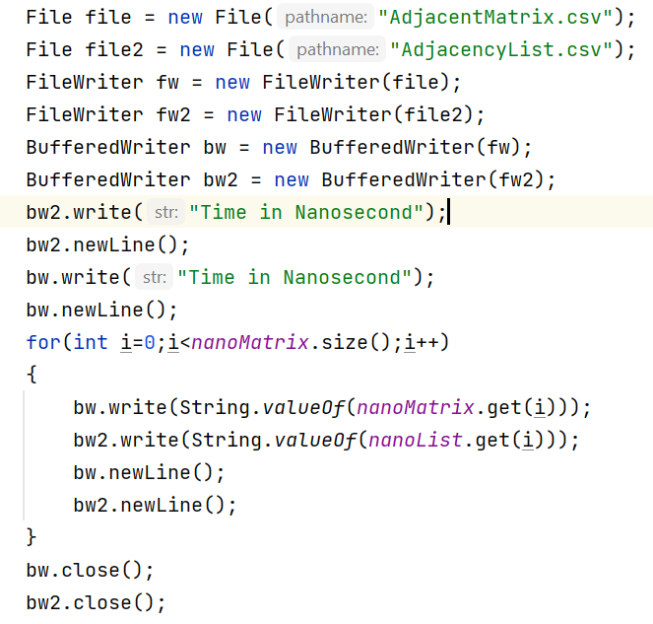
File Reader

Slide 36
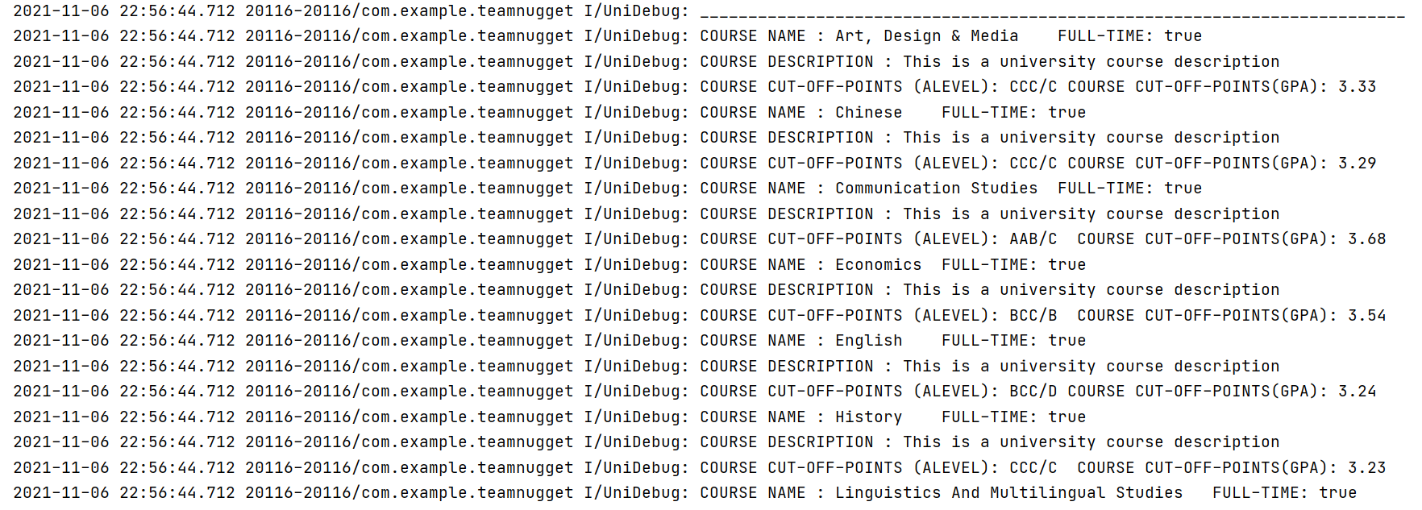
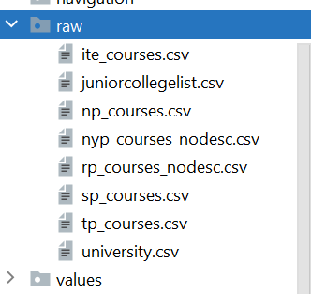
Solution: CSV Parse
Challenges #2 Reading data efficiently

Slide 37
Potential Improvement
Have a proper database system to query our data efficiently. Having a database also allows expandability.
Improve filter search algorithm.
Have a online chat system. This allows students to connect with respective institute via a chat.
Have more visuals and statistics. Eg (probability distribution of entry requirement).

Slide 38
06
Demo

Slide 39
Q & A

